Slide 1
Tools
Communication: Google Code
Version Control: SVN
UML: LucidCharts

Slide 2
Code Details
Written in Python with Pygame library
Easier to learn.
Flexibility. Ability to have more control and do more in a few lines of code.
Cross platformming – Can run in Linux, Windows, and Macintosh OS.

Slide 3
Code Challenges
Physics – Projectile motion, gravity, and motion vectors.
Mathematics – Collision detection (SAT theorem), finding angles paths
AI – How should enemies react to the player?
Data Structures – Handling projectiles in stacks, map as a hash table.

Slide 4
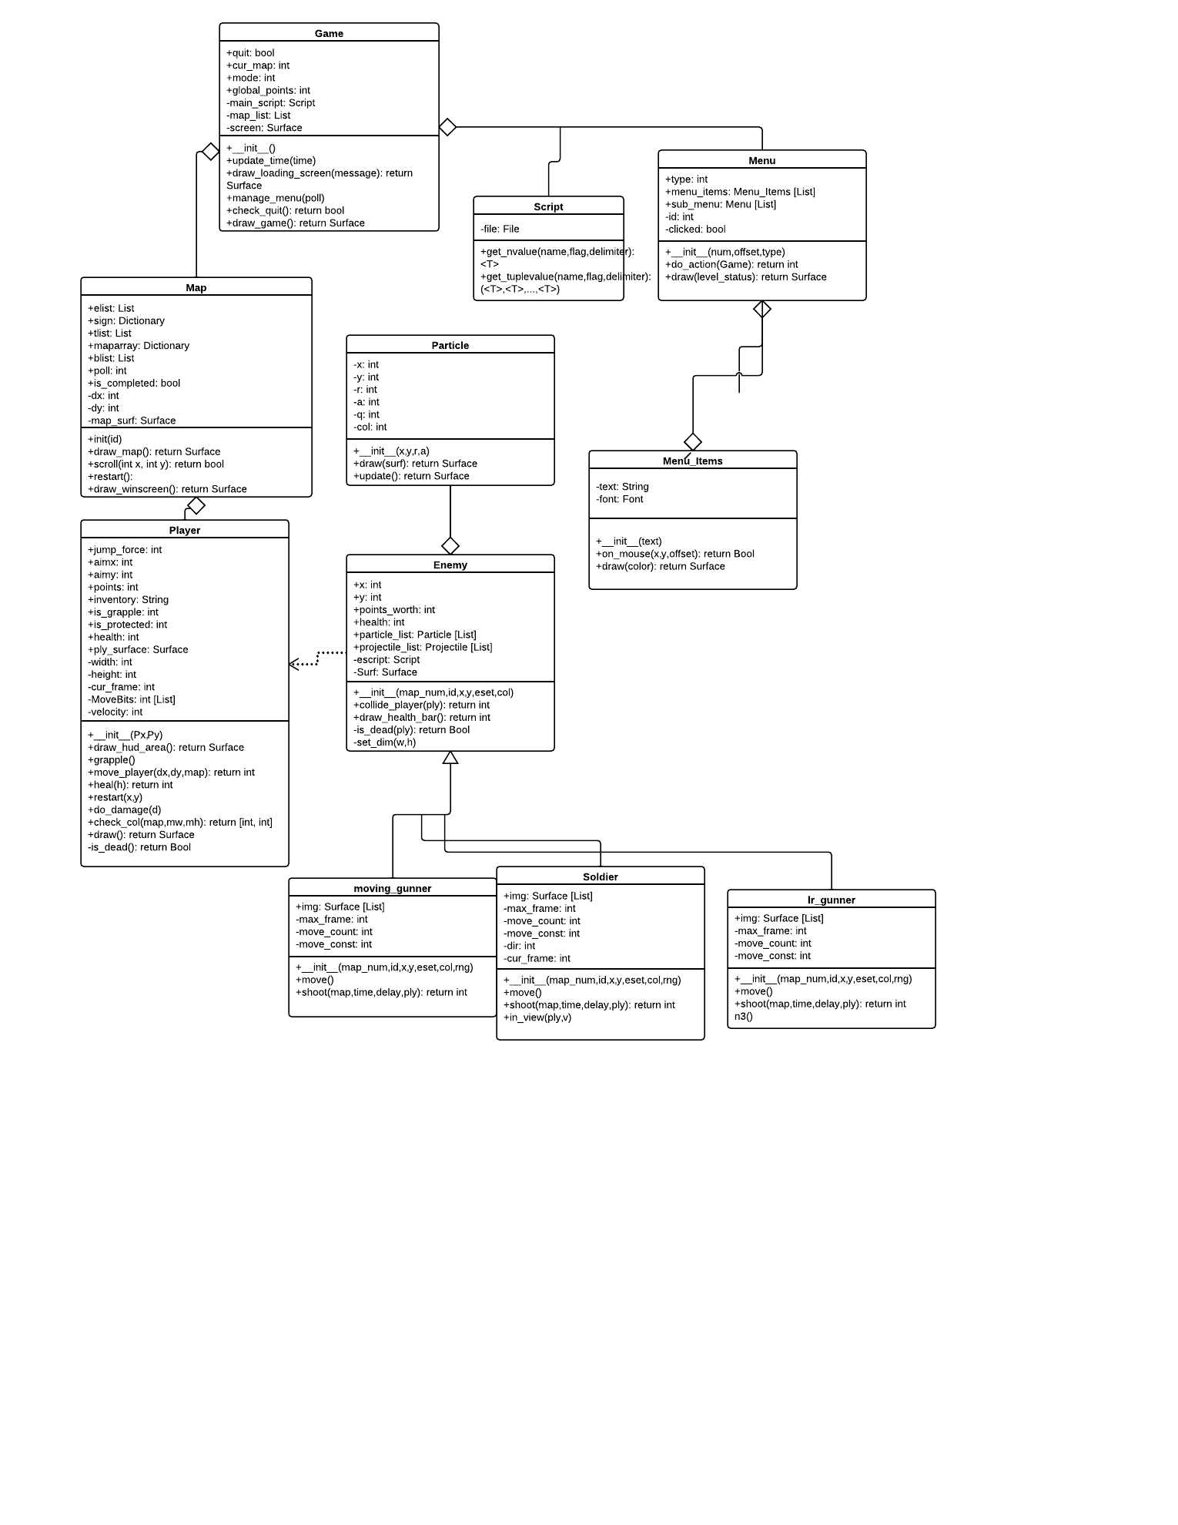

Slide 5
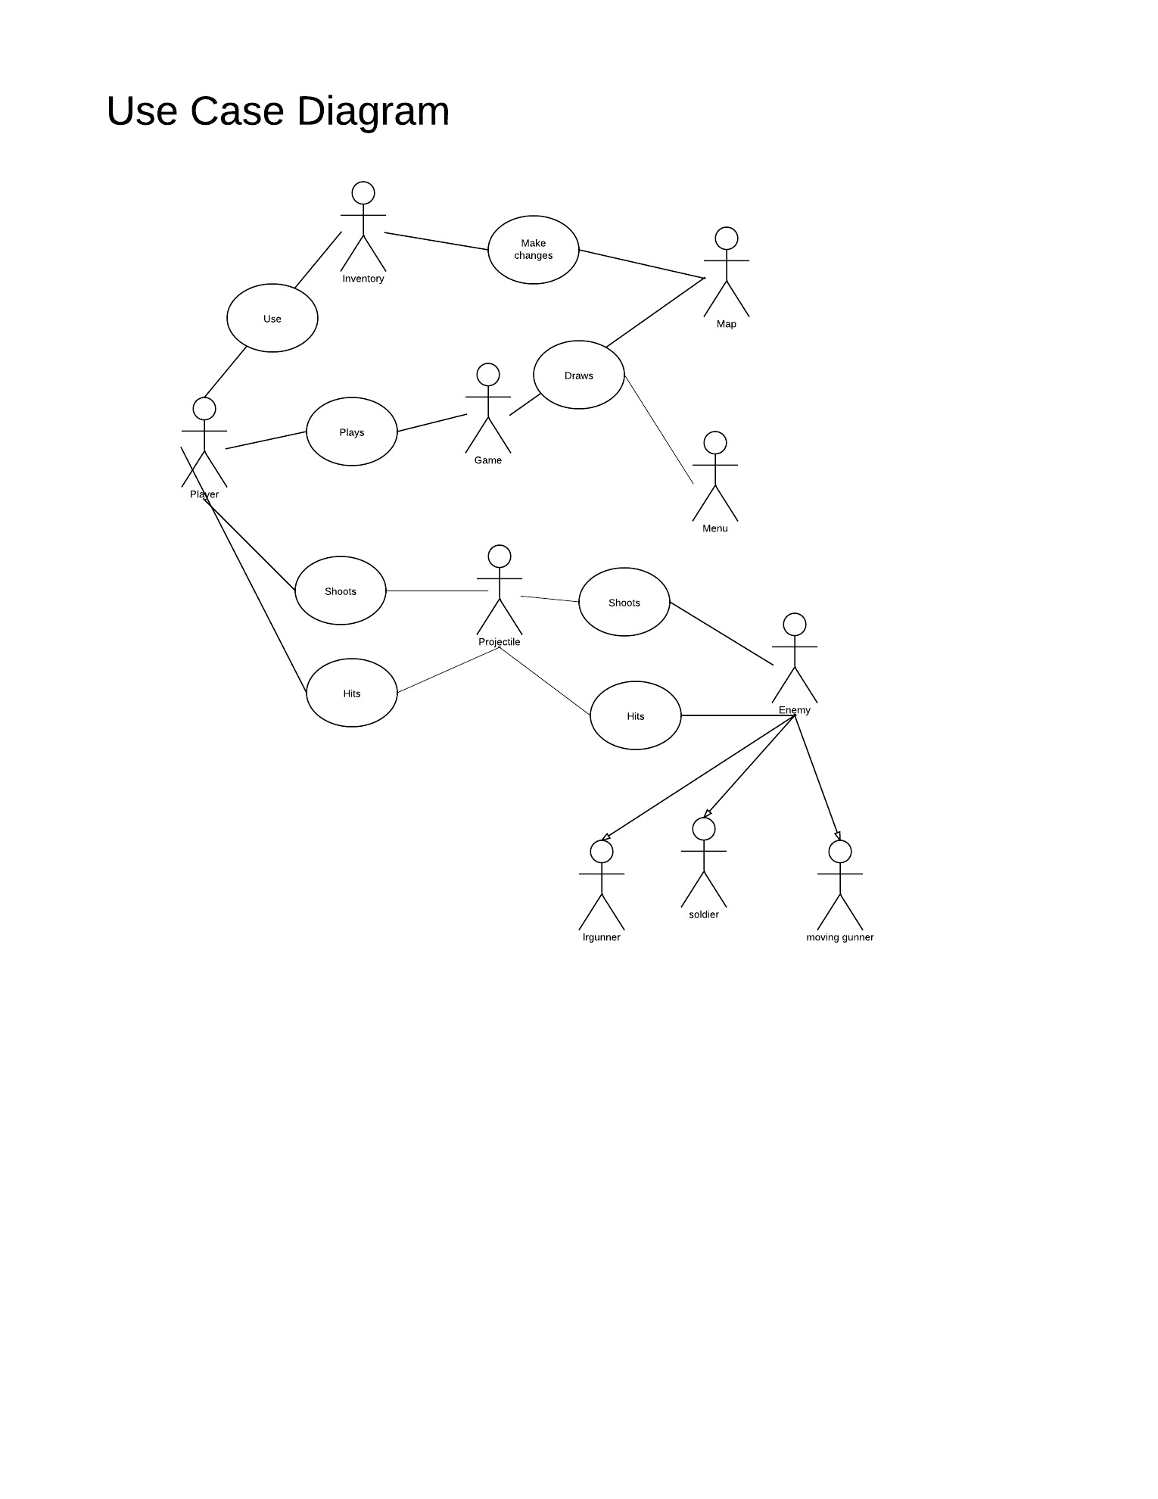

Slide 6
Schedule
Week 1 (Sept 12th) – What should our project be?
Week 2 (Sept 19th) – Requirements documentation
Week 3 (Sept 26th) – Code planning: UML, language, libraries.
Week 4 (Oct 3rd) – Menu, map, and player initiations.

Slide 7
Schedule
Week 5 (Oct 10th) – player movement, basic collision detection
Week 6 (Oct 17th) – gravity, adv. Collision detection, background, scrolling
Week 7 (Oct 24th ) – HUD display, loading screen, obstacles, health items
Week 8 (Oct 31st ) – Enemies automation, projectile automation, menu selection, basic particles, tutorial map

Slide 8
Schedule
Week 9 (Nov 7th) – Map switching, objectives, and enemy AI
Week 10 (Nov 14th) – Inventory list, points, and most of the graphics.
Week 11 (Nov 21st) – Two more presentation levels, working abilities, more enemies, and finished artwork.
Week 12 (Nov 28th) – Prepare presentation, last minute bug fixes,

